Slide 1

WEYLAND ENERGY
Brand Basics
Everything you need to make Weyland look like Weyland

Slide 2
Who we are
• We develop, build and operate wind, solar and storage assets that deliver affordable clean power to communities across Northern Europe.
• Tagline: “Clean power, built to last.”
• Personality: clear, grounded, optimistic, never hype
WEYLAND ENERGY · Brand Basics
2

Slide 3
Our colours
Colour | HEX | Use
Deep Sea | #0B3C5D | Primary, headings, title bars
Teal | #1FA2A6 | Accent, links, highlights
Sun | #F2B134 | Charts, call-outs (sparingly)
Mist | #EEF3F6 | Backgrounds
Slate | #4A5A68 | Body text
Coral / Leaf | #E4572E / #5BA65B | Negative / positive values only
WEYLAND ENERGY · Brand Basics
3

Slide 4
Typography
• Arial for all documents, slides and email
• Headlines in Deep Sea, bold
• Body 10.5 pt in documents, minimum 14 pt on slides
WEYLAND ENERGY · Brand Basics
4

Slide 5
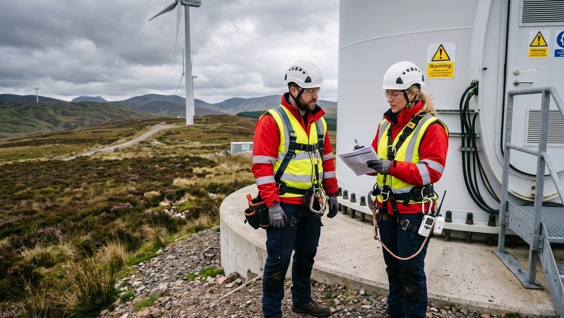
Photography
Real people, real sites, correct PPE – always

Slide 6
Templates
• Document, slide and spreadsheet templates are in the Brand Assets space
• Logos: use the files from Brand Assets, never screenshots
• Questions: Ravi Shah (Graphic Designer)
WEYLAND ENERGY · Brand Basics
6
Notes:
Point people to the Brand Assets space; don't attach logos to emails.

Slide 7
WEYLAND ENERGY
Thank you
Marketing & Communications · brand@weyland-energy.example

